Slide 1

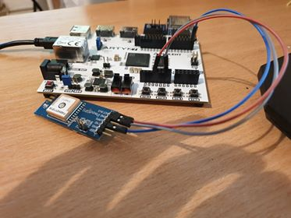

Enhanced GPS with accelerometer
Voica Stefan
Transilvania Univerity of Brasov

Slide 2

Enhanced GPS
with accelerometer
The purpose of the project is to complement loss of GPS signal or inaccurate GNSS signal measurement with motion analyzer.
,,Enhanced GPS with accelerometer’’ implemented on ArtyZ7 monitors and acquires physical data from GPS and accelerometer and transfers the data through WIFI protocol on a PC. On the PC an application written in Java computes the current position based on the acquired data: GPS coordinates and accelerometer X,Y,Z values. The GPS and accelerometer data could be viewed through a GUI (graphic user interface) implemented on the PC.

Slide 3
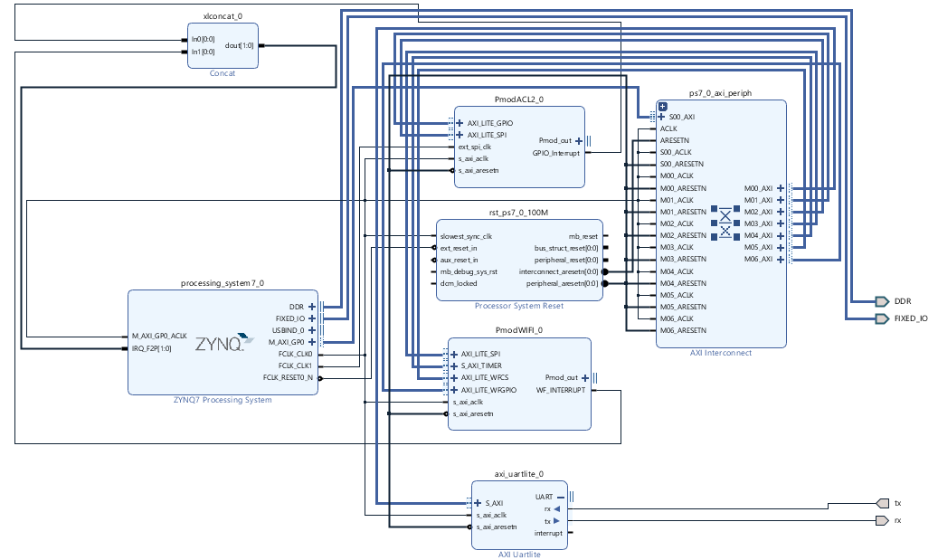
Hardware Architecture

Slide 4
Software Architecture
The software part is composed of 2 parts:
C application which runs on Arm microprocessor; acquires data from GPS and accelerometer and transfer those values on the PC using Wifi
Java application which runs on PC, receives data from the board and computes the current position of the board.
For this software application we will use coordinates and GUI algorithms to print on the screen our data from board , transferred via WiFi. For this kind of process, we’ll need a TCP (Transmission Control Protocol) based on a client (board) and a server (notebook).

Slide 5
Software Architecture
The software application implemented in Java is summarized in the below figure:

Slide 6

How to use the application?
The device can be configured using 3 simple steps:
1.Loading the bitstream and .elf file on Arty board
2.Start the software on the laptop
3.Establish the connection between the server and the client (laptop and board).
.

Slide 7


Establish connection between the server and the clietn
Start the hotspot with configuration listed on the bottom and start the software.
If right configured, it will auto peer and will start the transmission of data from device to server.
The process might take up to 1 – 1:30 minutes depending on the wifi card and signal power.
When start streaming the data from a side to another, it will auto log the data to .dta files on the local folder. We implemented offline log to make developers and users use data as statistics or certain usage. The program works synchronized , such as the log is written and the data is shown to user in the same time without any bug.
Network name | stefan1234
Network password | test1234

Slide 8
Example Usage
.For example, you can use it as car tracking , you would know where is your car every second. This might be a very useful anti-stealth tool.
Pare ceva uzual insa v-ati gandit ca aceasta aplicatie este folositoare mai ales in cazul in care vi se poate fura masina ori nu mai stiti locatia exacta unde ati lasat-o? Ganditi-va ca acest dispozitiv va poate conferii informatiile de care aveti nevoie in timp util , ba chiar mai mult , functioneaza in mod rapid si efficient astfel ca fiecare secunda din timpul dvs. este esentiala.

Slide 9



Concluzii si credite
In concluzie , dispozitivul GPSwA ofera nu numai siguranta , precizie , corectitudine cat si fiabilitate dar si flexibilitate in domeniul transmisiei informatiilor dar si in ceea ce priveste dexteritatea in mediul de lucru.
Dorim sa multumim companiei Digilent pentru placuta si componentele oferite pentru dezvoltare si sa mentionam cateva referinte externe ce au facilitat evolutia si realizarea pe deplin a proiectului:Eclipse,LWJGL,Forum Digilent;

